Slide 1


DESIGN AND MODELLING OF DIRECT AC TO AC POWER CONVERSION TECHNOLOGIES FOR WIND ENERGY SYSTEM WITH FUZZY BASED PWM TRIGGERING SYSTEM
SUBMITTED BY,
VIJAI KRISHNA
DEEPAK. M
SHABIL SHAMSUDHEEN
GUIDED BY,
Dr. K. BOOPATHY b.e, m.e, PhD
Associate PROFESSOR
p. Poornima
Assistant professor
Department of eee

Slide 2
ABSTRACT
The aim of this paper are Novel AC to AC power conversion with high power switching devices to produce triggering pulse using fuzzy based optimization techniques and to fabricate hardware system of proposed model .The hardware component for this project includes the ac to ac metric converter, UJT triggering circuit – Duty Cycle, general view of wind blade. Based upon the economical and environmental circumstance nowadays, wind energy is gently obtaining interest as a suitable source of renewable energy, A grid connected wind power generation scheme using a doubly fed induction generator with a direct AC-AC matrix converter is deliberate with the use of fuzzy logic controller. PWM triggering technique has been utilized for ac-ac matrix converters.

Slide 3
OBJECTIVES
Novel AC to AC power conversion with high power switching devices.
To produce triggering pulse using fuzzy based optimization techniques
To fabricate hardware system of proposed model to verify simulation output.

Slide 4
EXISTING SYSTEM
EXPLANATION OF THE EXISTING SYSTEM
The wind mill at the small levels is much familiar in the present days. The existing system is a model developed with matrix converter for variable speed wind turbine driving an doubly fed induction generator with limitations of slow response time, less knowledge about drive system and occupies more space Mostly wind mill which do not have any control mechanism are mostly of standalone type or it will be used as backup power and will not play a major role in the energy scenario. Further things are explained in the block diagram.

Slide 5
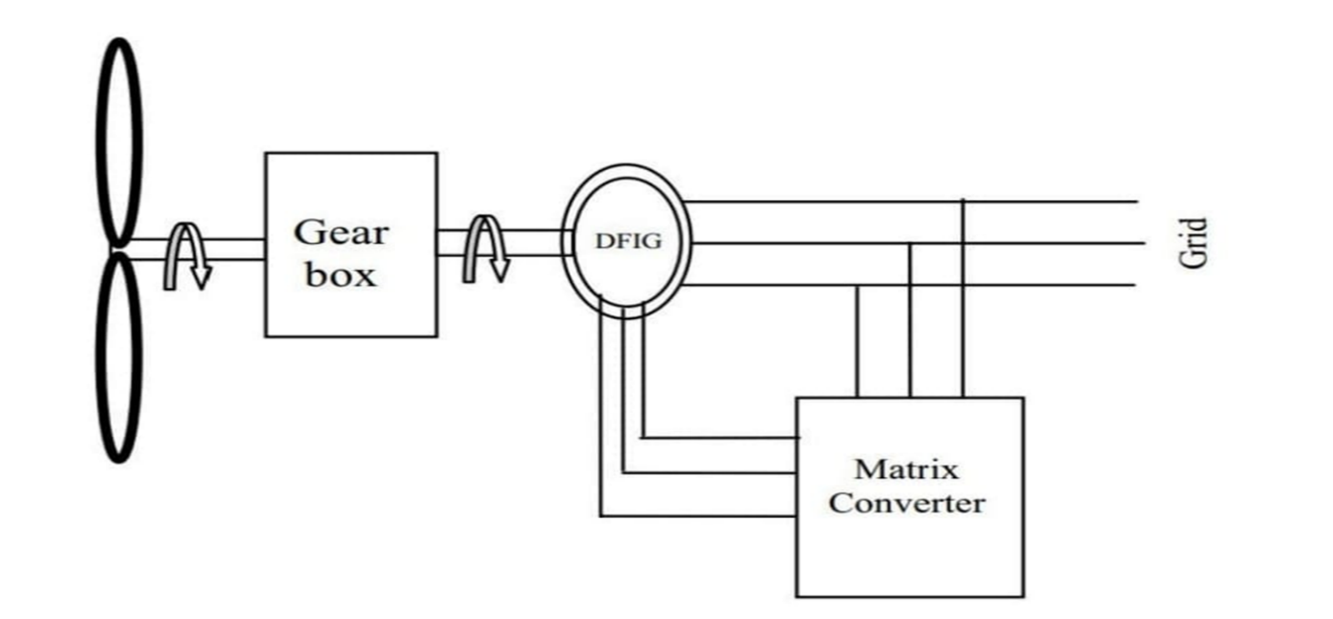
BLOCK DIAGRAM OF EXISTING SYSTEM

Slide 6
BLOCK DIAGRAM EXPLANATION OF THE EXISTING SYSTEM
The above block diagram explains the existing system. In a first part, we present the mechanical part represented the wind turbine and the electrical part represented by (Doubly Fed Induction Generator, Matrix Converter). The second part is devoted to the presentation of the power control algorithm, as well as the RST regulator. In order to control stator active and reactive power exchanged between the DFIG and the grid, a vector control strategy will be presented. The inverter connected will convert the DC to AC and it will be directly connected to the mains.
DISADVANTAGES OF EXISTING SYSTEM
1.Slow response time
2.Occupies more space

Slide 7
PROPOSED SYSTEM
EXPLANATION OF THE PROPOSED SYSTEM
An ac to ac converter using fuzzy logic system is been used in the proposed system. Better efficiency can be achieved by having a controller that can control the speed and have a proper generation even at lower speeds by using back propagation technique in artificial neural network

Slide 8
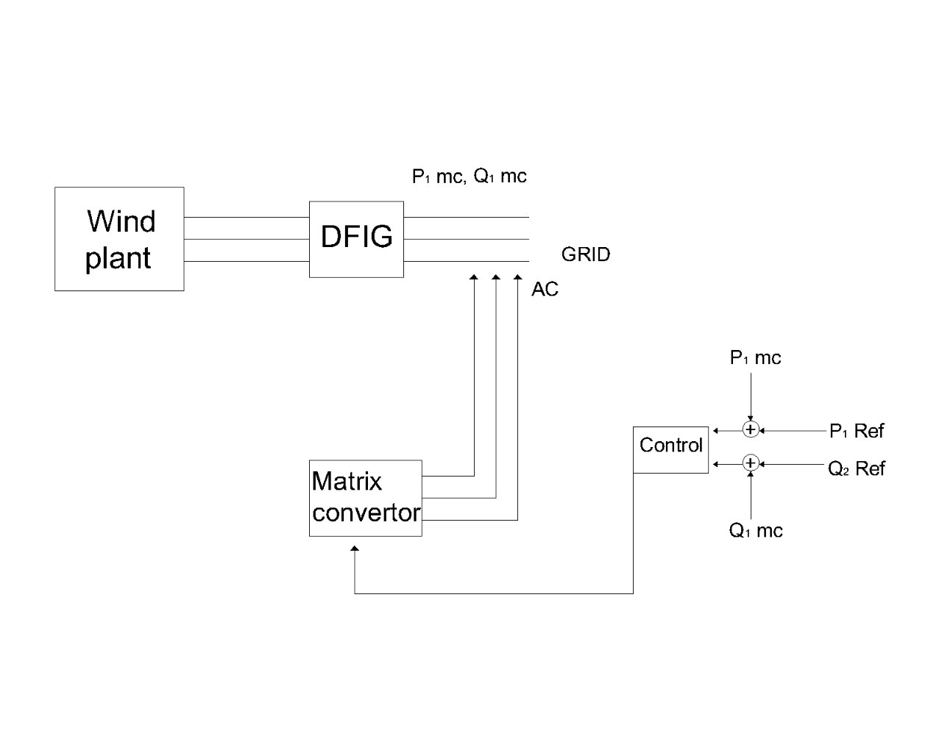
BLOCK DIAGRAM OF PROPOSED SYSTEM

Slide 9
EXPLANATION OF THE BLOCK DIAGRAM
The proposed system has a difference in the feedback system. Fuzzy logic system is being used to control the speed of the generator and deliver maximum output. The ac to ac converted the output from the Blades used Tacho sensors and delivers it to the fuzzy logic system which compares it with the reference speed and gives signal to change the gear ratio inside the gear box. All other operation remains same as the previous system.
ADVANTAGES OF THE PROPOSED SYSTEM
Simple and robust.
Fast response to the changing wind speed.
Easy to implement as does not need long mathematical equations and synthesis of the same in programming form.
Directly human logic can be applied and the system can be implemented using simple training methodologies.

Slide 10
COMPONENTS USED
Blades
Gear box
DFIG wind turbine system
Ac to Ac converter
UJT triggering circuit duty cycle

Slide 11
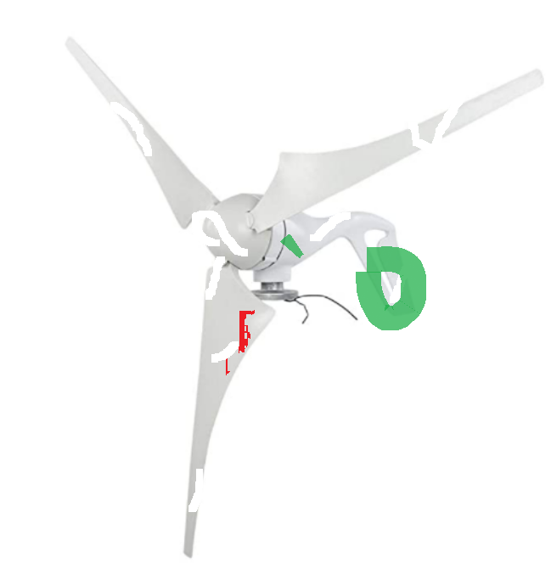
HARDWARE PROTOTYPE
BLADES
Most turbines have at least two blades, similar to the halves of an airplane's propeller. Many windmills have more than two blades Wind impacts these blades, causing "lift," making the windmill rotate. The approximate weight of a 600 KW machine is 1500 Kg.

Slide 12
GEAR BOX
Gear box is often used in a wind turbine to increase the rotational speed from a low-speed main shaft to a high-speed shaft connecting with an electrical generator. Gears in wind turbine gearbox are subjected to severe cyclic loading due to variable wind loads that are stochastic in nature.
DFIG Wind Turbine System
DFIG wind turbine doubly-fed induction generator (DFIG) system is a popular system in which the power electronic interface controls the rotor currents to achieve the variable speed necessary for maximum energy capture in variable winds. Because the power electronics only process the rotor power, typically less than 25% of the overall output power, the DFIG offers the advantages of speed control with reduced cost and power losses. This PLECS demo model demonstrates a grid-connected wind turbine system using all of PLECS' physical modelling domains. The system model includes a mechanical model of the blades, hub, and shaft, a back-to-back converter including thermal loss calculations, a magnetic model of the three-phase transformer, and the transmission line and grid.

Slide 13
AC TO AC CONVERTER
AC to AC converters is used majorly. For obtaining a desired AC power supply from the actual power supply, we need some converters called AC to AC converters.AC to AC converters is used for converting the AC waveforms with one particular frequency and magnitude to AC waveform with another frequency at another magnitude. This conversion is mainly required in case of speed controlling of machines, for low frequency and variable voltage magnitude applications as well. We know that there are different types of loads that work with different types of power supplies like single-phase, three-phase supply, and the supplies can be differentiated based on the voltage and frequency range also.

Slide 14
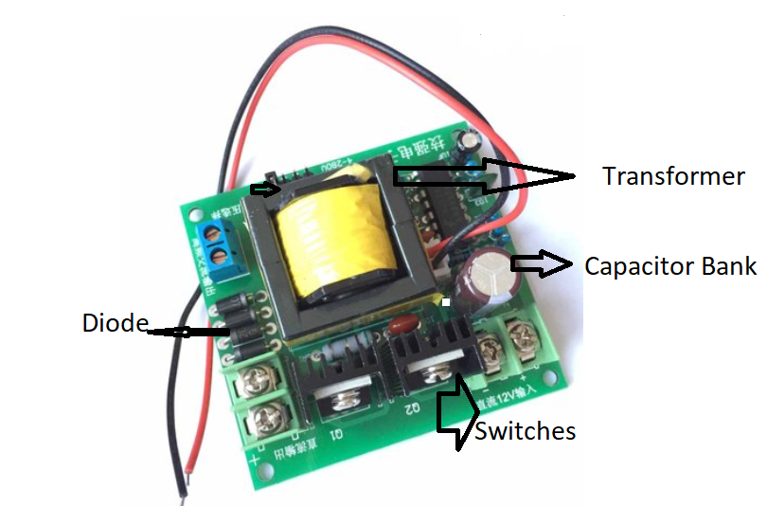

Slide 15
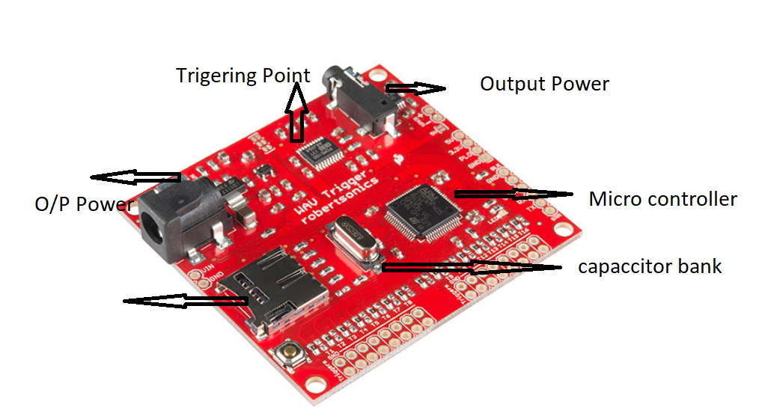
UJT TRIGGERING CIRCUIT-DUTY CYCLE
A unijunction transistor (UJT) is an electronic semiconductor device that has only one junction. Has a lightly doped n-type silicon layer to which a heavily doped p-type emitter is embedded. The inter-base resistance is in the range of 5 – 10 kΩ. This device cannot ‘amplify.

Slide 16
RESULT
The hardware prototype of the direct ac to ac power conversion connected directly to the grid through the stator, and controlled by through its rotor circuit an ac/ac direct converter. To control the power exchanged between the stator and the network, one uses the vector control with direct stator flux .Shows random wind turbine speed. Note that before the application of a level of active power the current is null whereas the voltage is equal to that of the grid. opposition compared to appears in the stator of the machine .The machine supplies a grid with the stator active power .The sizes (stator current and voltage) are independent of the variation of the wind and depend only on the active and reactive reference powers. shows active and reactive stator powers .shows the active and reactive rotor power .The active power varies according to the wind speed. For g>0, DFIG absorbs a rotor active power. For g < 0, DFIG supplies grid with a rotor active power. Fog = 0, the rotor active power remained constant corresponding to the rotor joules losses. For g = 0, the reactive power is null. The grid power varies according of the wind turbine speed. The active and reactive grid power, the rotor voltage and current waveforms .The frequency of these voltage and current, vary according to the rotor voltage and current are continuous.

Slide 17
CONCLUSION
In the first phase of the project the literature survey on the wind mill and its parameters was studied. The basic operational mechanism of a wind mill is being studied. Various generators used in the wind mill according to the application were also studied. The analysis of the ac to ac power conversion using fuzzy logic system was selected as it is used in the small scale wind mills which will play an important role in the future smart grid. Three basic methodologies namely Power electronics speed control, Fuzzy based speed control and speed controls were studied. The relative be based control and Fuzzy based system has been done and appropriate output waveforms have been taken.

Slide 18
REFERENCE
[1] S.Zahang ,King Tseng, T.D Nguyen. “ Modeling of AC-AC matrix converter for wind energy conversion system” ,IEEE 4th Annual conference on Industrial Electronics and applications,2009.
[2] S.Marmouh , M.Boutoubat , L.Mokrani. “ Fuzzy logic controller of a wind energy conversion system based on a PMSG” 8thInternational Conference on Modelling, Identification and Control (ICMIC), 2016.
[3]Omer Abbaker, Ahmed Abood Awad. “Control of wind turbine for variable speed based on fuzzy-PID controller” SUST Journal of Engineering and Computer Sciences (JECS), Vol. 18, No.1 ,2017

Slide 19
[4] K.Ghedamsi, D.Aouzellag, E.M.Berkouk.“ Application of Matrix Converter for Variable Speed Wind Turbine Driving an Doubly Fed Induction Generator” International Symposium on Power Electronics, Electrical Drives, Automation and Motion, SPEEDAM 2006.
[5] Luis Arturo Soriano, wen Yu, and Jose de Jesus Rubio.“ Modeling and Control of Wind Turbine” Departament de Control Automatic, CINVESTAV, National Polytechnic Institute, 07360 Mexico City, DF, Mexico, 2013.

